Slide 1
Resource Guide
Certified Peer Recovery Specialist –
Aaliyah Davis
The Consortium @ CCCF

Slide 2
Employment
Accu Staffing
911 N Kings Highway, NJ 08034
(856) 482-2222
accustaffing.com
Mon-Fri 8AM-5PM
1601 Market St. Philadelphia, Pa 19103
(215) 568-2228
Mon-Fri 8Am-5Pm
J&J Staffing
1814 Marlton Pike E Ste 210, Cherry Hill, NJ 08003
(856) 751-5050
Mon-Fri 8:30am-5pm
Ameritemps
608 Broadway, Camden, NJ 08103
(856) 966-0999
ameritempsinc.com
Mon-Fri 8am-5pm
Randstad
1700 Market St Ste 1500, Philadelphia, PA 19103
(610) 265-3844
randstadusa.com
Mon-Fri 8am-5pm
Temp Agencies

Slide 3
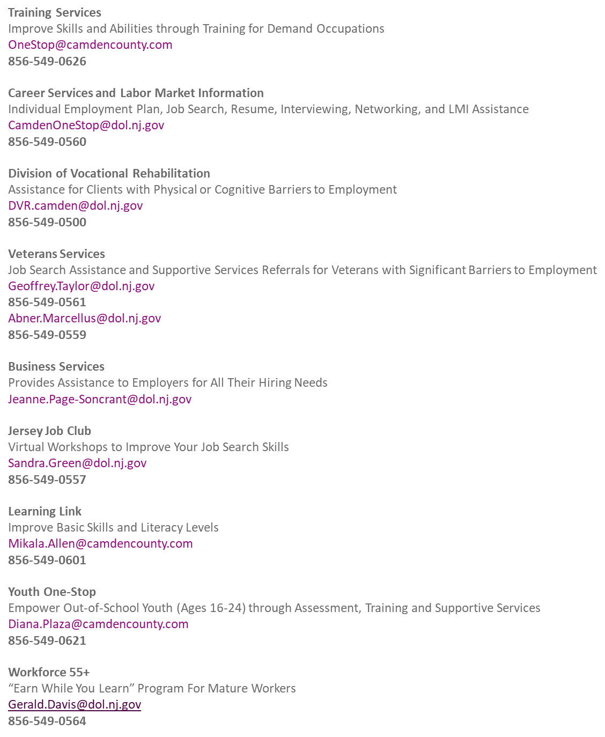

Slide 4
Clothing & Food Services
Feast of justice
Mentioning counseling, help with SNAP benefits and outdoor market to Philadelphia residents
3101 Tyson Ave, Philadelphia, PA 19149
(215) 268-3510
feastofjustice.org
Monday Closed
Tuesday 9 AM - noon
Wednesday 4 PM - 7 PM
Thursday 10 AM - noon
Friday Closed
Saturday 10 AM – noon
1 PM - 4 PM
Sunday Closed
Antioch Baptist Church
Clothing and food giveaway for all ages and, families.
690 Ferry Ave, Camden, NJ 08104
(856) 966-7023
Tuesday: 9am-2pm
Wednesday: 9am-2pm
Thursday: 9am-2pm
MUST BRING ID
Broad Street Ministry
Lunch, mail, hygiene services
315 S. Broad St. Philadelphia, Pa 10107
(215) 735-4847
Monday-Friday : 11:30am-3pm
ID Signup & Mail : First Tuesday & Wednesday of each month
Clothing : Tuesday & Thursday 11:30am-1pm
Personal Care : Wednesday 11:30am-2pm
Mobile Hygiene Truck
Monday 1pm-3pm
5206 Rodman St. Philadelphia, Pa 19143

Slide 5
Clothing & Food Services Continued..
Catholic Charities
Counseling, housing assistance, prison ministry, welfare to work, and substance abuse
1845 Haddon Ave, Camden, NJ 08103
(856) 342-4100
Mon-Fri : 8:30am-4pm
Ujima Friends Peace Center
Food bank
1701 W Lehigh Ave, Phila Pa 19132
267-679-4601
1st and 3rd Saturday Monthly
9am until foods gone
The Father Center
Dress2impress, forklift certification, 24/7 father parenting classes, anger management, computer literacy, healthy relationships, etc.
1 West State St. Trenton, NJ 08608 5th Floor
(609) 695-3663
Mon-Fri : 9am-5pm
Thefathercenter.org

Slide 6
Healthcare Services
Gateway Health Center
817 Federal St,
Camden, NJ 08103
Monday - Friday
8am - 5pm
Extended Hours
Monday & Wednesday
8am - 8pm
Saturday
9am - 1pm
CAMcare North
6th &, Erie St,
Camden, NJ 08102
Monday - Friday
8am - 5pm
CAMcare South
8th & Carl Miller Blvd
Camden, NJ 08104
Monday - Friday
8am - 5pm
CAMcare East
2610 Federal St #1936
Camden, NJ 08105
Monday - Friday
8am - 5pm
CAMcare Clementon
121 White Horse Pike #4158, Clementon, NJ 08021
Monday - Friday
8am - 5pm
Extended Hours
1st Saturday of the month 9am - 1pm
856-583-2400

Slide 7
Emergency Housing Programs
Agape House - offers emergency housing and case management services to single adults and families with children to residents in Somerset County.
Location: 122-128 E. Main Street, Somerville, NJ 08876
Contact: (908) 707-9753
Aletha R. Wright “Vision of Hope” Center - is a 69-bed low barrier, emergency housing program for single, adult men experiencing homelessness in southern New Jersey.
Location: 271 Atlantic Avenue, Camden, NJ 08104
Contact: (856) 966-0909
Amani House - a 25-bed transitional housing program for single, adult men experiencing homelessness in Mercer County.
Location: 518-520 Martin Luther King Boulevard, Trenton, NJ 08618
Contact: (609) 393-3168

Slide 8
EMERGENCY HOUSING CONTINUED..
Eleanor Corbett House - a 52-bed emergency housing program providing shelter and case management services to single women and families residing in Gloucester County.
Location: 355 Union Street, Glassboro, NJ 08028
Contact: (856) 881-5550
Home for the Brave - a 30 bed, low demand transitional housing program for single, male veterans. Funded through the United States Department of Veterans Affairs, Home for the Brave is the only low demand housing program for veterans in New Jersey.
Location: 271 Atlantic Avenue, Camden, New Jersey 08104
Contact: (856) 966-0909
Anna Sample Complex- 93 bed Transitional Housing program serves single women and families in Camden County.
Location: 408-416 Line Street, Camden, NJ 08103
Contact: (856) 963-0430
Joseph’s House
Location: 555 Atlantic Ave, Camden, NJ 08104
Contact: (856) 246-1087

Slide 9
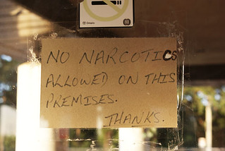
Narcotics Anonymous
Front Line Group
422 Market St. Camden, NJ | Saint Pauls Episcopal Church
Monday, Wednesday, Saturday
9am-10am
Afternoon Recovery Group
422 Market St. Camden, NJ | Saint Pauls Episcopal Church
Sunday-Thursday
12pm-1pm (Open on Holidays)

Slide 10
Narcotics Anonymous Continued...
Recovery In The Morning Group
4800 Wayne Ave Philadelphia, Pa 19144
Happy Hollow Recreational Center
Thursday, Saturday, Sunday
9am-10am (Open Holidays)
Surrender Around The Way Group
428 N. 41st Philadelphia, Pa 19104
Mount Pisgah Church
Monday & Wednesday
1pm-2pm (Open Holidays)
On The Right Track Group
451 S. University Ave Philadelphia, Pa 19104
The Consortium
Tuesday & Saturday
5:30pm-6:30pm
Vison of Love Group
502 Broadway | Camden, NJ 08103
Faith Baptist Church
Wednesday 5:30pm-6:30pm

Slide 11
Woman Support
Women Against Abuse
100 S. Broad St. Suite 1341 | Philadelphia, Pa 19110
(215) 386-1280
Monday-Friday
12pm-8pm
Womenagainstabuse.org
Women Organized Against Rape
1617 John F. Kennedy Blvd. Suite 800 |Philadelphia, Pa 19103
(215) 985-3315
Monday-Friday
9am-5pm
Woar.org
Women Recovery Houses
1117 Morris St. | Philadelphia, Pa 19148
(267) 380-1630
24Hour Hotline
(Call or Text for program hours as they are confidential)
Womenrecoveryhouses.com
freeridetorehab@gmail.com

Slide 12
Woman Support Continued…
Camden County Domestic Violence Center
311 Market St. | Camden, NJ 08102
(856) 963-5668 | (856) 227-1234 (24Hour Toll-Free)
Monday-Friday
8am-5pm
State of New Jersey Parent Link
www.nj.gov/njparentlink
Resources w/ health & wellness, family support, education, career transitions, behavior & mental health

Slide 13
LGBTQ+
Resources for Human Development |MORRIS HOME
4700 Wissahickon Avenue | Suite #126, Philadelphia | PA 19144-4248
(215) 951-0300 | 1-800-894-9925 (Toll-Free)
www.rhd.org
Office of LGBT Affairs
City Hall |Room 110 |Philadelphia, PA 19107
(215) 686-0330
https://www.nj.gov/njyrs/services-resources
Office of LGBT Affairs | Homepage | City of Philadelphia
Garden State Equality
1408 Main Street |Asbury Park, New Jersey 07712
(973) 509-5428
https://www.gardenstateequality.org/

Slide 14
Extras
Expungement
Njcourts.gov (type expungement in the search bar for the specific page)
Psp.pa.gov (type expungement in the search bar for the specific page)
Free Clinics
Osborn Family Health Center
1601 Haddon Ave, Camden, NJ 08103
(856) 757-3700
osbornfamilyhealthcenter.com
8am-5pm Monday-Friday
Bellmawr Clinic
35 East Browning Rd.
Bellmawr, NJ 08031
856-931-2700
8:30am-5pm Mondays Only
Health Center #2
1700 S. Broad St. Unit 201, Philadelphia, Pa 19145
215-685-1803
Monday & Tuesday
8 a.m. – 4:30 p.m.
Wednesday
7:30 a.m. – 4:30 p.m.
Thursday
8 a.m. – 7:30 p.m.
Friday
8 a.m. – 4:30 p.m.
Saturday
8 a.m. – 12pm
Drexel University Community Wellness HUB
3509 Spring Garden, Philadelphia, PA 19104
Dornsife Center | Carriage House 2nd Floor
(215) 571-3241
Monday-Friday
9am-4:30pm
(Case management, clinical treatment for uninsured, STD screening, health education, etc.)

Slide 15
Extras Continued…
ID Assistance
Philly Restart – 19th and Vine(in front of free library) Mondays 4pm-5pm HOT MEAL AVAILABLE (have social worker contact at helpinghandphilly@gmail.com)
Center for Family Services- 854 Benson St. Camden, NJ 08103 (Mon-Fri 9am-5pm)

